Slide 1

Movie Recommendation System
Presentation by-
Sree Charan Mudiya. (1226119507)
Niyaz Ali Sindhwani. (1225751722)
Omkar Rajendra Gaikwad. (1226843997)
Harshal Rajesh Tingre. (1226039050)

Slide 2

Agenda
Problem Statement & Motivation.
Methods.
Implementation.
Results.
Conclusions.
Future Work.
Q&A.

Slide 3

Problem Statement & Motivation
Explain why recommendation systems are important (personalization, sales, engagement etc.)
Goal is to recommend movies to users based on their preferences
Using content-based filtering approach

Slide 4

Methods
Content-based filtering overview
Computes similarity between movie attributes and user preferences
Limitations: restricted exposure, inability to explore

Slide 5
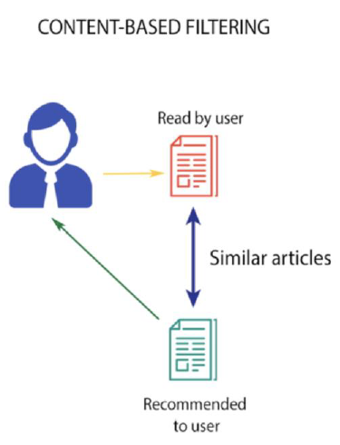
Content-based Filtering
Definition: Content-based filtering is a recommendation approach suggesting items similar to those previously liked by the user. It assesses similarity, often utilizing cosine similarity, between user preferences and item attributes like lead actors, directors, and genres.
Example: If a user enjoys 'The Prestige', the system recommends movies featuring 'Christian Bale', within the 'Thriller' genre, or directed by 'Christopher Nolan'.
Limitations: Despite its effectiveness, content-based filtering has drawbacks. It limits users' exposure to diverse products, hindering exploration and potentially impeding business growth as users might be hesitant to try new items.

Slide 6
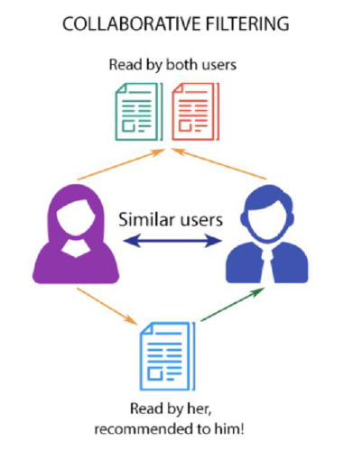
Collaborative Filtering
Definition:
Collaborative filtering is a recommendation strategy that considers user behavior and compares it to other users in the database. Unlike content-based filtering, it generates suggestions based on the interactions of multiple users with items.
Differentiation:
In contrast to content-based filtering, collaborative filtering doesn't rely solely on an individual user's data for modeling. It takes into account the collective influence of multiple users, emphasizing the collaborative nature of the recommendation algorithm
Key Concept:
The critical concept in implementing collaborative filtering is understanding how the combined actions and preferences of a group of users influence the recommendation outcomes.

Slide 7
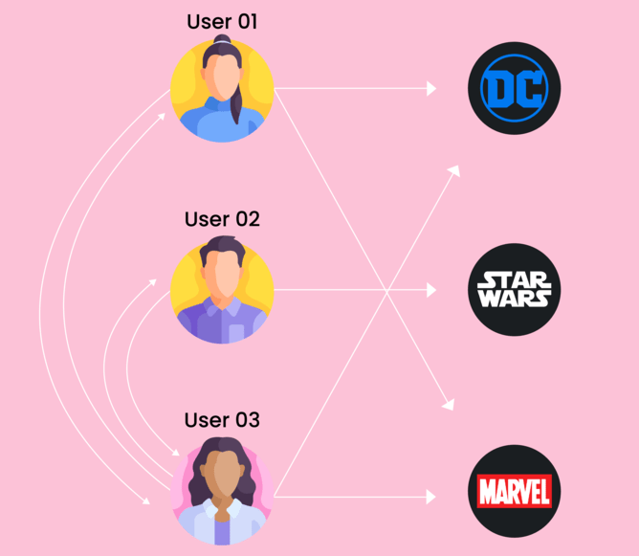
User-based Collaborative Filtering
Objective: Recommending items to a user (A) based on the preferences of other users in the database.
Process:
Construct a matrix of items rated/liked/clicked by each user.
Compute similarity scores between users.
Recommend items that user A hasn't seen but that similar users have liked.
Disadvantages:
Fickle User Preferences: Shifts in user preferences over time can lead to inaccurate recommendations.
Large Matrices: Vulnerability to Shilling Attacks

Slide 8

Item-based Collaborative Filtering
Approach: Recommends items to user 'A' based on the similarity of items rather than users.
Process:
Look for similar movies based on previous preferences of user 'A.'
Find pairs of movies rated/liked by the same users.
Calculate similarity across all users who rated both movies.
Recommend similar movies based on the calculated similarity scores.
Advantages over User-based Collaborative Filtering:
Consistent Movie Preferences: Movies do not change, leading to more consistent recommendations.
Simplified Matrices: Fewer items than users simplify the maintenance and computation of matrices.
Resilience to Shilling Attacks: Difficult to manipulate as items cannot be faked, making the strategy more robust.

Slide 9

Implementation
Imported necessary libraries (Pandas, Numpy etc.)
Loaded and preprocessed datasets (credits, movies)
Defined functions to clean data, merge datasets, convert text
Built recommendation function to take movie title as input and output 10 similar movies

Slide 10
SAMPLE CODE AND DATASET- The dataset used in this demonstration are movie “credits.csv” and “movies.csv”.
Movie dataset has:
MovieId – once the recommendation is done, we get a list of all similar movieId and get the title for each movie from this dataset.
genres – which is required for this filtering approach.

Slide 11
Sample Code and DATASET

Slide 12
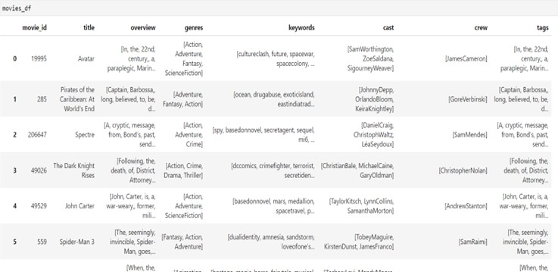
SAMPLE CODE and DATASET

Slide 13

Recommendation Function
Check if movie in database
Identify similar movies by content
Return top 10 suggestions

Slide 14
Results
Even they are not similar titles they come under the similar genre and similar cast.

Slide 15
Results
we get similar movie titles with the input title.
They also come under similar genre, cast and crew.

Slide 16
Conclusions
Successfully recommended relevant movies by content
Effective data preprocessing
Intuitive input/output functionality
Shows promise for small-medium datasets

Slide 17

Future Work
Switch to collaborative filtering
Improve input flexibility
Incorporate additional data sources
Regularly update movie data
Add user personalization
Scale system for larger data
Evaluate precision and recall

Slide 18
REFERENCES
https://www.analyticsvidhya.com/blog/2020/11/create-your-own-movie-movie-recommendation-system/
https://drive.google.com/drive/folders/10P7C-suaBAA5_ZAi4oEO_Pmsb7kG6JMZ
https://labelyourdata.com/articles/movie-recommendation-with-machine-learning
https://towardsdatascience.com/how-to-build-a-movie-recommendation-system-67e321339109
https://www.mygreatlearning.com/blog/masterclass-on-movie-recommendation-system/

